Slide 1

MERIL WEBINAR
GASTRIC CANCER
LAPAROSCOPIC GASTRECTOMY :
THE STATE OF THE ART

Slide 2
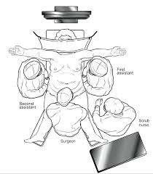
Laparoscopy in Oncology - rationale
Guarantee or improve survival
Decrease morbidity
Optimize professional training
Decrease costs
Evidence based context

Slide 3
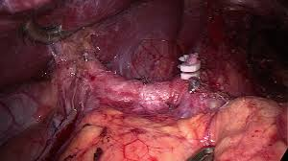
VLP Gastrectomy - Background
Kitano 1991: 1st VLP gastrectomy
  videoassisted BI STG
  early gastric cancer
Uyama 2000: 1st D2 VLP gastrectomy
  advanced gastric cancer

Slide 4
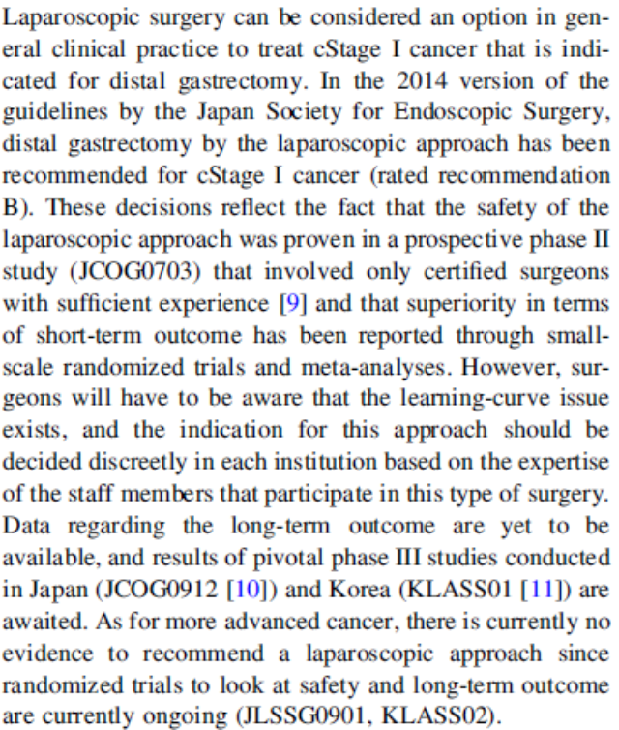
JGCA GUIDELINES 2014
JCOG 0703
Early tumors – 176 patients
Fase II – VLP STG
Fistula = 1,7%
Grade 3/4 complications = 5,1%
VLP STG = SAFE PROCEDURE!

Slide 5
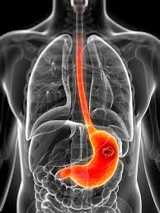
RETROSPECTIVE TRIALS

Slide 6
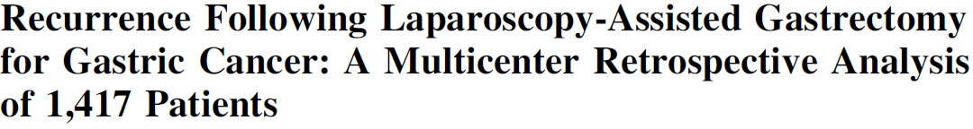

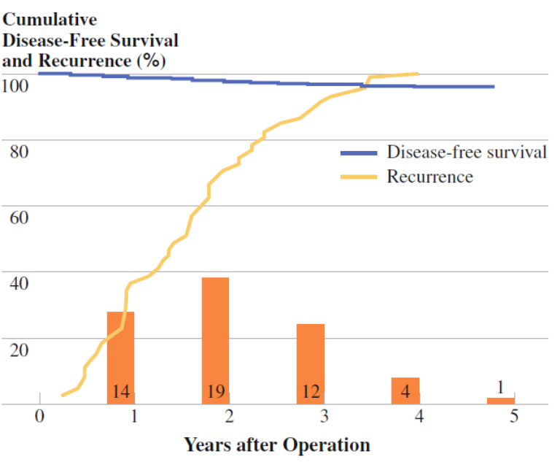
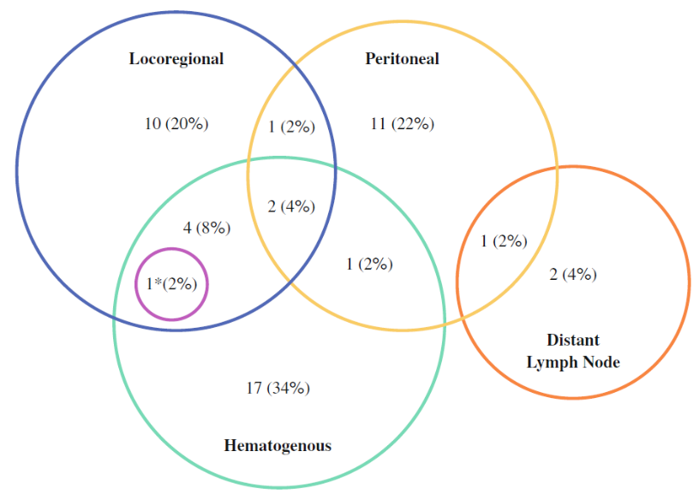
Song et al. Ann Surg Oncol 2010
Recurrence in early gastric cancer = 1,6% (19/1186)
Recurrence in advanced gastric cancer = 13,45% (31/231)
NO RECURRENCE in trocar portals and incision

Slide 7
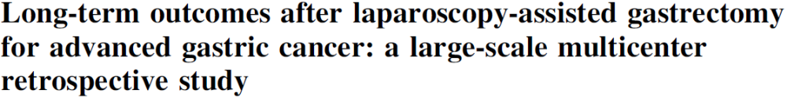
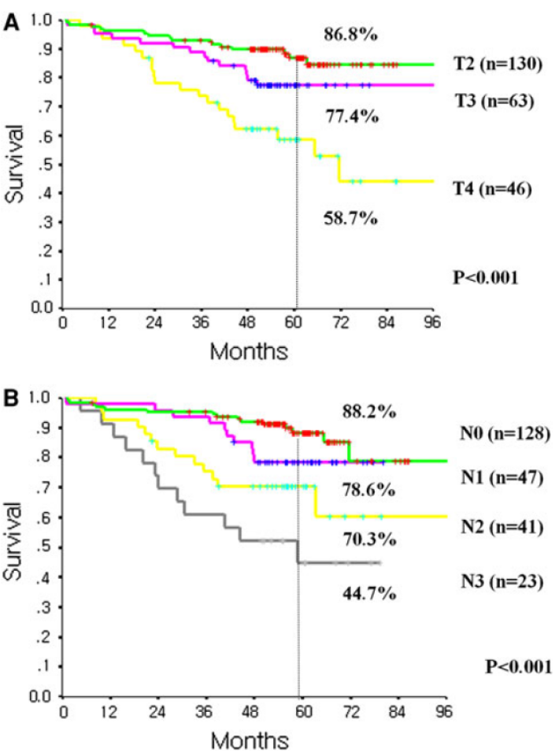
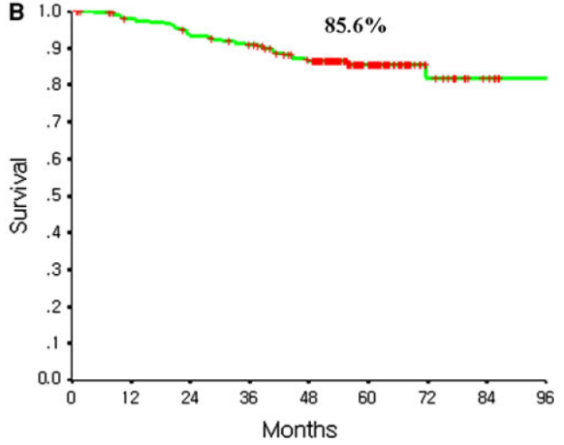
Park et al. Surg Endosc 2012
239 patients
10 hospitals
10 surgeons
D1+ : 76 pts
D2: 163 pts

Slide 8
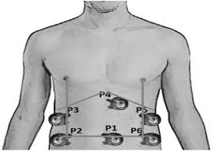
Prospective Randomized Trials

Slide 9



JCOG 0912
Multicentric / fase III (JCOG 0703: VLP STG = safe surgery)
921 pts (BMI ~ 22,5!!!)
Tumors Ia / Ib
VLP STG vs OPEN STG
Primary Endpoint: 5 years overall survival
Secondary Endpoints: QOL, time for 1st flatus, temperature...
Minilaparotomy < 6cm (VLP)
Surgeons included:
  OPEN: > 60 surgeries
  VLP: > 30 surgeries

Slide 10
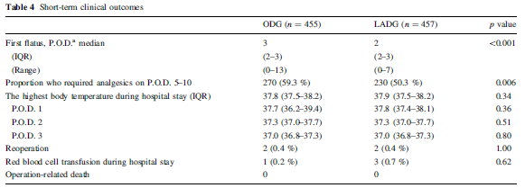
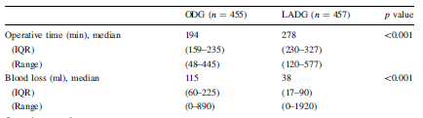

JCOG 0912 – Preliminary Results

Slide 11
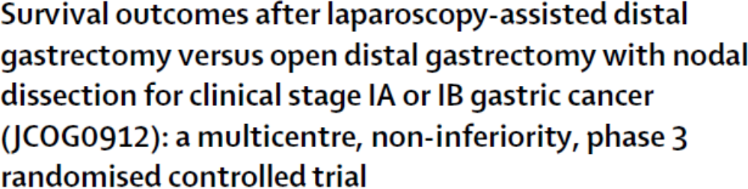

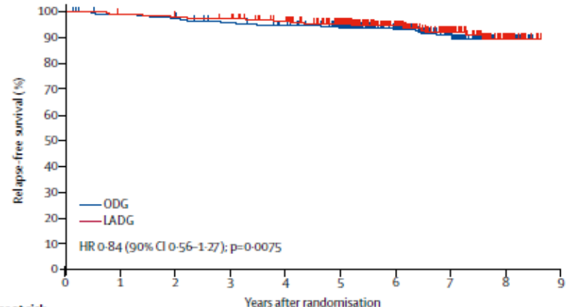
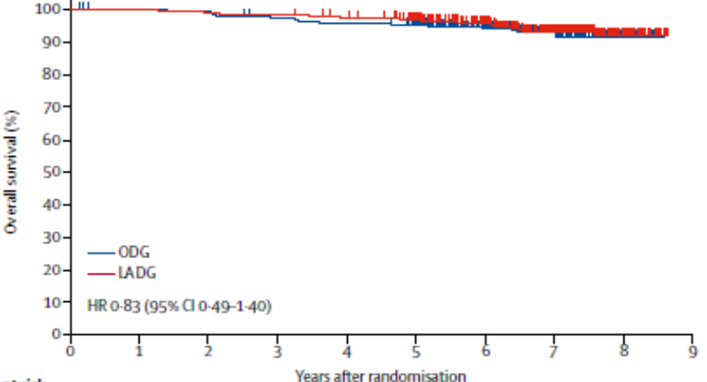
Lancet 2019
RFS
OS

Slide 12
JLSSG 0901
Sang-Woong Lee et al JCO 2017
Fases II/III
460 pts
cT2-T4a cN0-2
VLP STG vs OPEN STG
Primary Endpoint (fase II): anastomotic or pancreatic fistula
Primary Endpoint (fase III): recurrence free survival

Slide 13

JLSSG 0901
Sang-Woong Lee et al JCO 2017
 | VLP STG | OPEN STG | p
Blood loss | 30 ml | 150 ml | < 0,001
Analgesics | 38,3 % | 53,6% | 0,001
First day to flatus | 2 days | 3 days | < 0,001
Intra-op complications | 0,9% | 2,6% | 0,285
>= Grade 3 post-op compl. | 3,1% | 4,7% | 0,473
Mortality | 0,4% | 0,4% | -----------
Operative time | 291 min | 205 min | <0,001
Conclusions: Credentialed surgeons could safely perform laparoscopic distal gastrectomy with D2 lymph node dissection for locally advanced gastric cancer. The laparoscopic approach could be accepted without increasing major surgical complications in this setting.

Slide 14
KLASS 01
Kim H-H et al. Ann Surg 2010 / JCO 2016
Fase II/III
1203 / Stage I
VLP STG vs OPEN STG
 | VLP STG | OPEN STG
Morbidity | 13,7% | 18,9%
p | 0,009
Mortality | 1,1% | 0%
5 yr OS | 96,4% | 96,3%
p valor | 0,317
5 yr RFS | 92,9% | 94,7%
p | 0,368

Slide 15

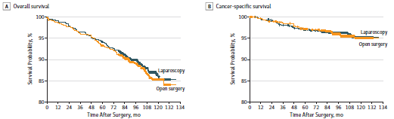
Kim H-H et al. Ann Surg 2010 / JCO 2016

Slide 16
KLASS 02
Lee et al. Ann Surg 2019
RCT / advanced gastric cancer (KLASS 01: VLP STG = safe procedure in early cancer)
1050 pts
D2 VLP STG vs D2 OPEN STG
Limphadenectomy on stations 4sb and 4d!!!
Primary Endpoint : 3 yr OS
Surgical quality:
  Surgeon: > 50 VLP gastrectomies
  Hospital: > 80 gastrectomies / year

Slide 17
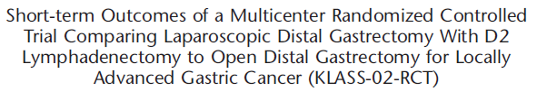
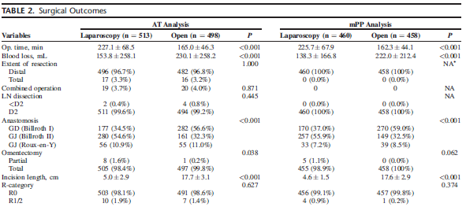
Lee et al. Ann Surg 2019

Slide 18
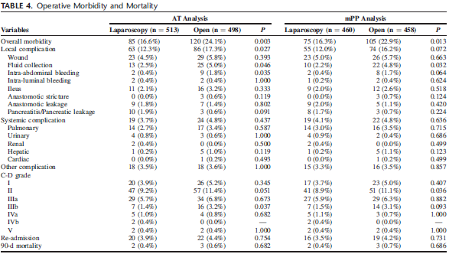
Lee et al. Ann Surg 2019

Slide 19
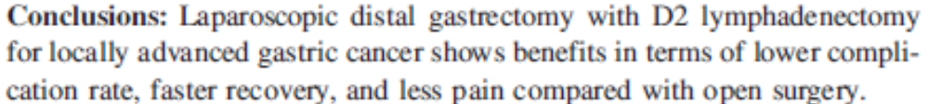
Lee et al. Ann Surg 2019
D2 VLP STG = SAFE PROCEDURE !!!

Slide 20
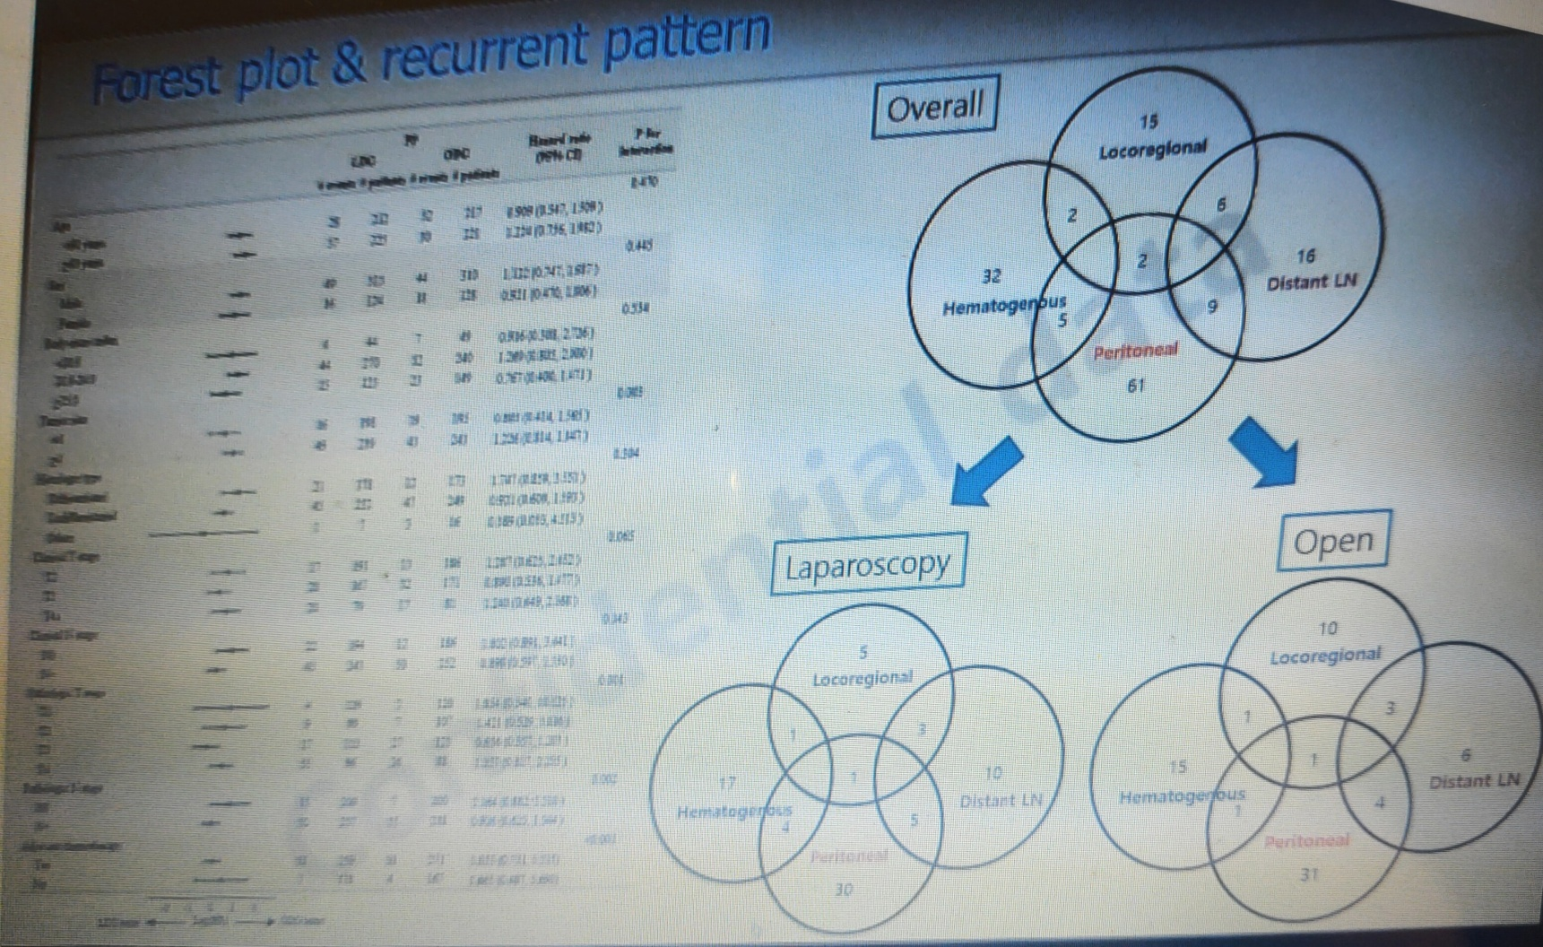
KLASS 02 – Recurrence Pattern

Slide 21
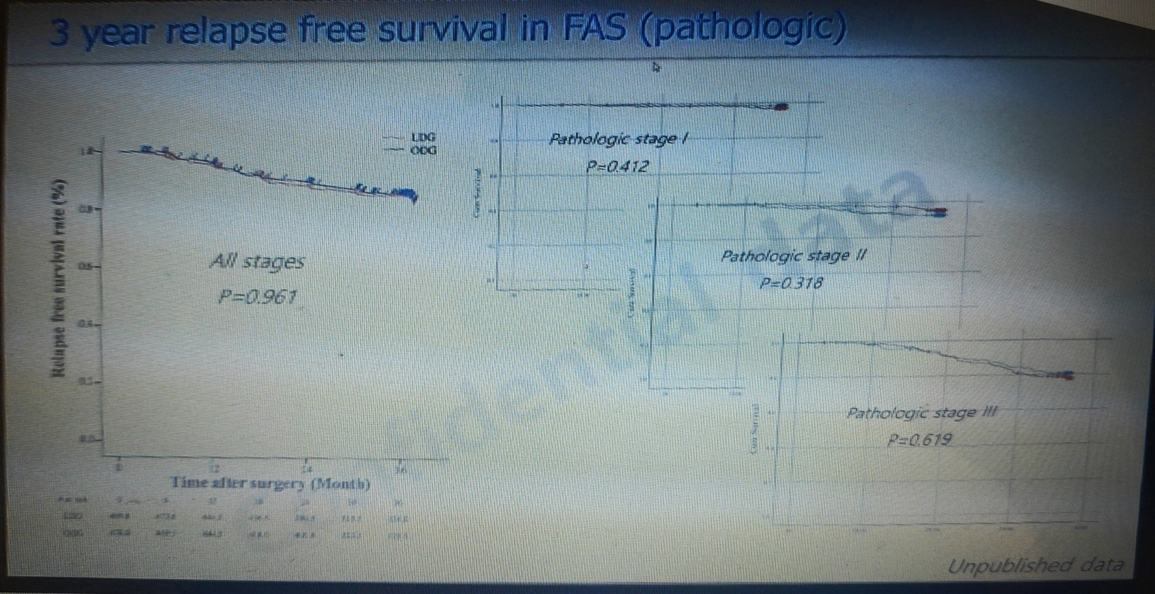
KLASS 02 – DFS

Slide 22

CLASS 01
Yu J et al, JAMA 2019
Fase III
1039 pts
cT2/T3/T4a cN0-3
D2 VLP STG vs D2 OPEN STG
ASCO 2018 | Gastrectomia VLP | Gastrectomia aberta
3 yr DFS | 76,5% | 77,8%
HR | 1,069
p | NS
3 yr OS | 83,1% | 85,2%
HR | 1,162
p | NS

Slide 23

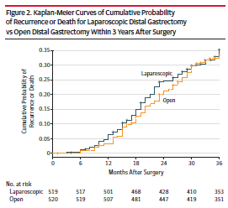
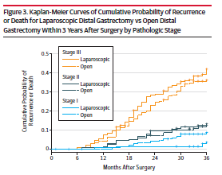

Yu J et al, JAMA 2019

Slide 24

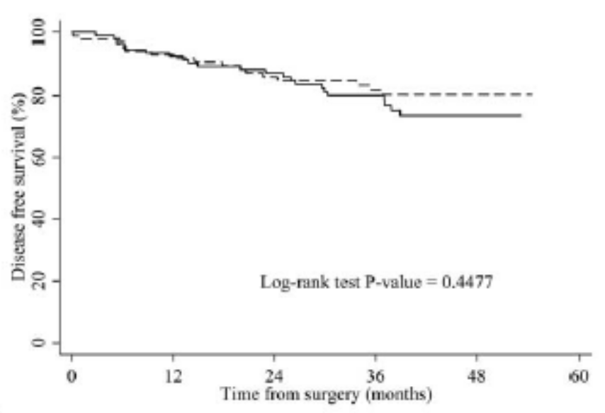
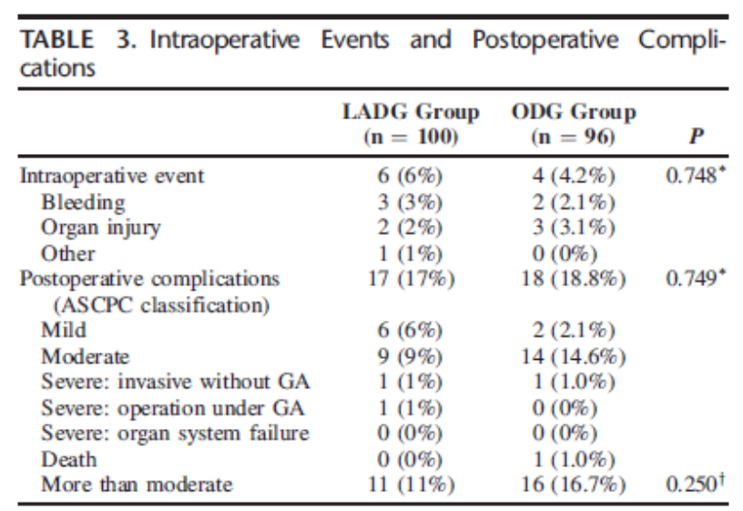
COACT 1001
Park YK et al. Ann Surg 2017
Multicentric fase II RCT
cT2-T4a / cN0-N2
D2 VLP STG – 100 pts
D2 OPEN STG – 96 pts

Slide 25
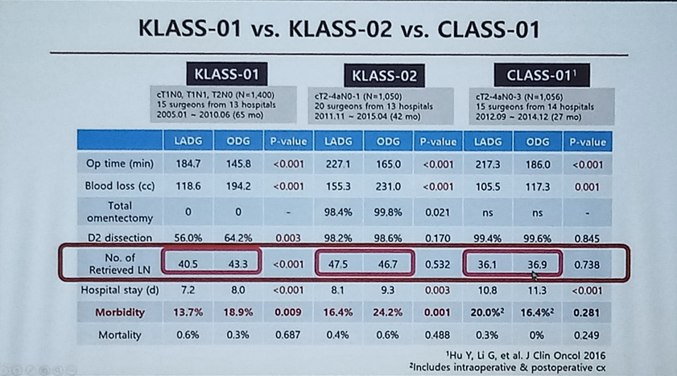

Slide 26
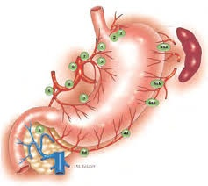
METANALYSIS

Slide 27

Viñuela et al. Ann Surg 2012
25 trials: 6 RCTs / 19 NRCTs (3055 pts)
AJCC Stage I: 89% D2 lymphadenectomy: 53%
VLP STG:
< morbidity
< blood loss
< length of stay
same mortality
> operative time
< lymph nodes (same proportion of patients with 15 or more LFNs in the specimen)

Slide 28
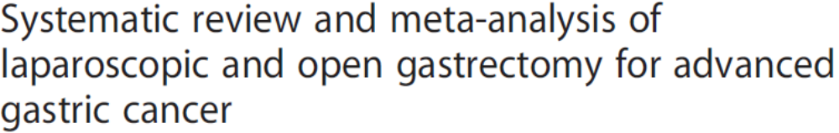
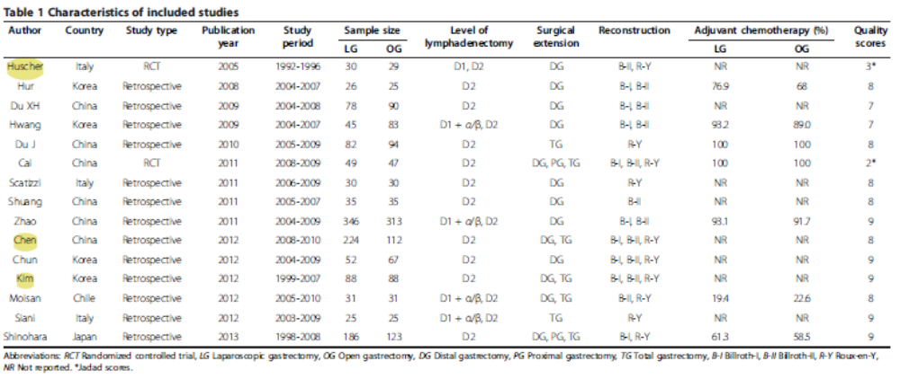
Chen et al. WJSO 2013
VLP Gastrectomy: < morbidity, length of stay and blood loss; faster peristalsis / same number of lymph nodes, mortality and recurrence / > operative time

Slide 29
Wei et al. Surg Laparosc Endosc Percutan Tech 2011
10 studies, 1039 pts (1 RCT / 9 case-control)
D2 VLP Gastrectomy:
< blood loss
< pain
faster recover of peristalsis
< morbidity
< length of stay
same number of lymph nodes
same overall survival
> operative time

Slide 30

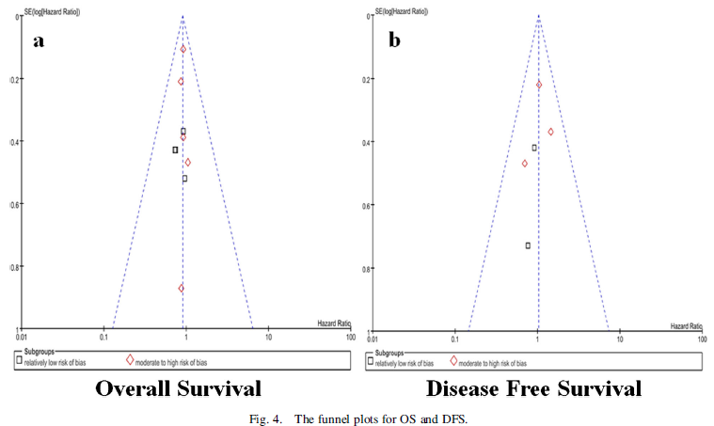
Choi et al. J Surg Oncol 2013
10 studies (1 RCT / 9 cohort – 1819 pts)

Slide 31

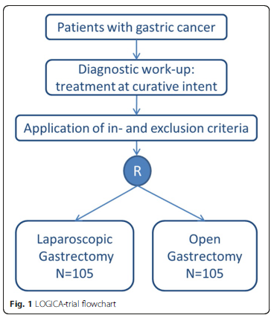
LOADING... LOGICA TRIAL
10 hospitals
210 patients
cT1-cT4a / NO-N3b / MO

Slide 32


CONCLUSIONS
VLP Gastrectomy shows better results in the immediate postoperative time (JCOG 0912 / JLSSG 0901 / KLASS I / KLASS 2)
Requires a learning curve and thorough technique
Long-term results seem to be equivalent to the open gastrectomy
Should we wait for the ongoing RCTs to define the approach as “ standard ” for gastric cancer?

Slide 33
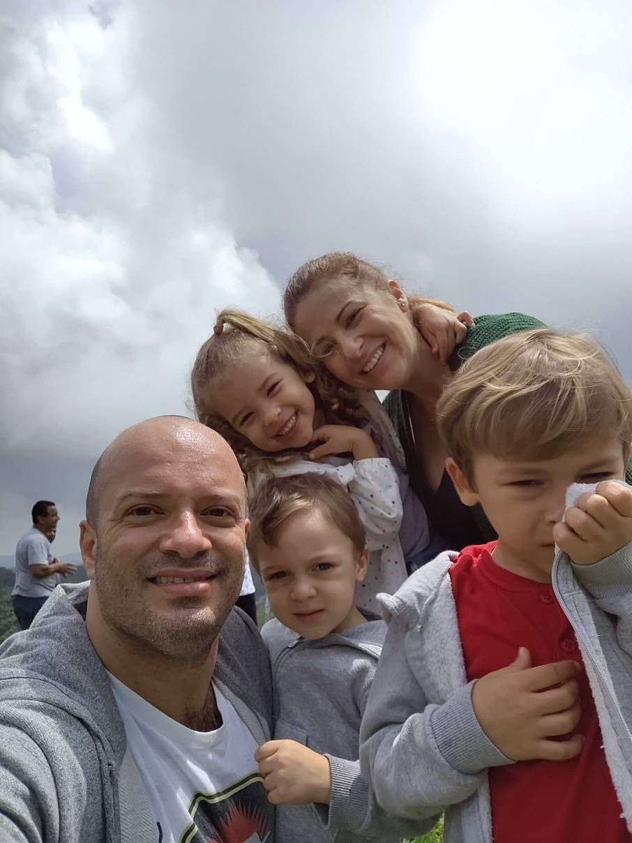
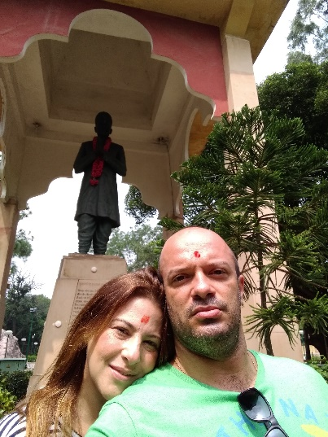
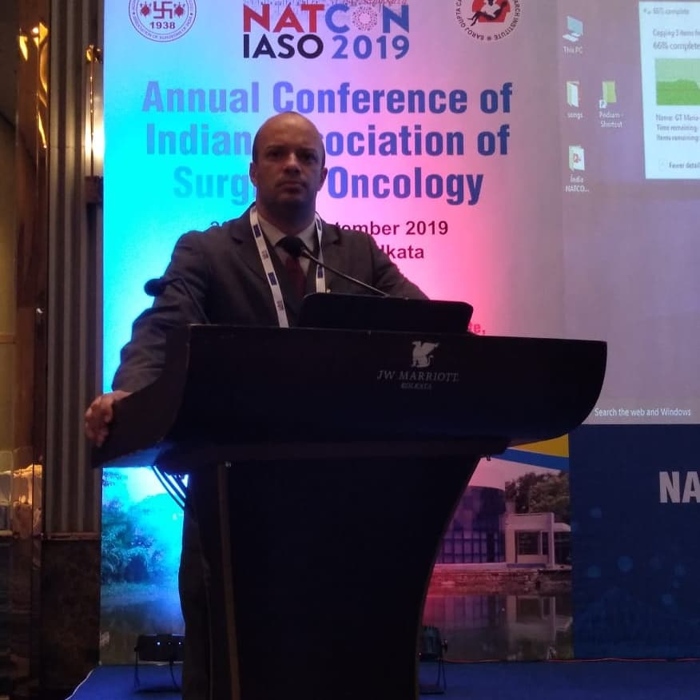
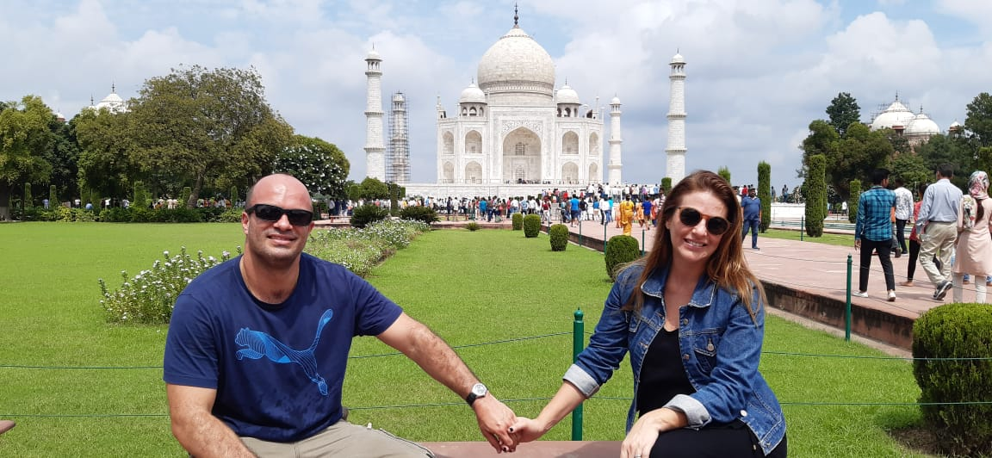
I BELIEVE IN LAPAROSCOPIC GASTRECTOMY!

Slide 34


“LIFE IS ART...
AS...
SURGERY IS ART”
ANDRE_MACIEL1977
WWW.DOUTORANDREMACIEL.COM.BR

